Slide 1
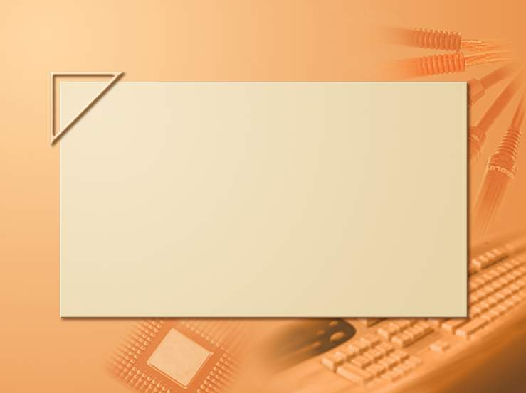
Last lecture TBD by Kfir / Shimon
Lecture 13-2

